Slide 1
HNDIT2417
Mobile Application Development
Introduction to Android Programming

Slide 2
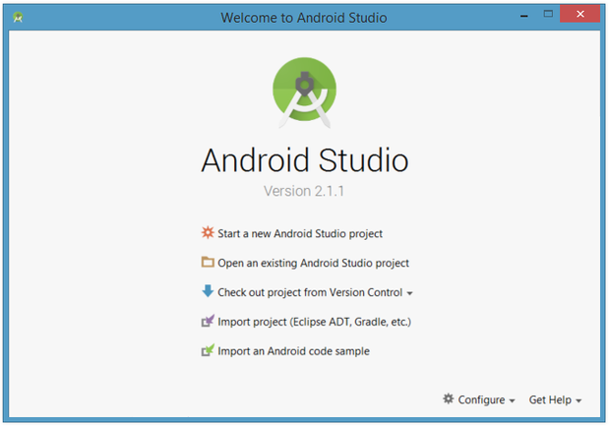
Starting a new project

Slide 3
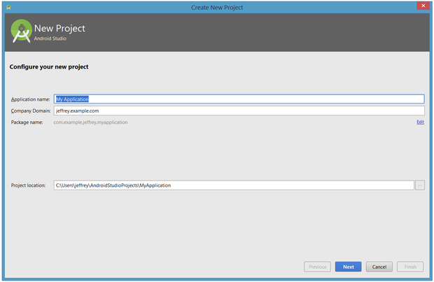
Starting a new project
Application Name
Company domain
Project name

Slide 4
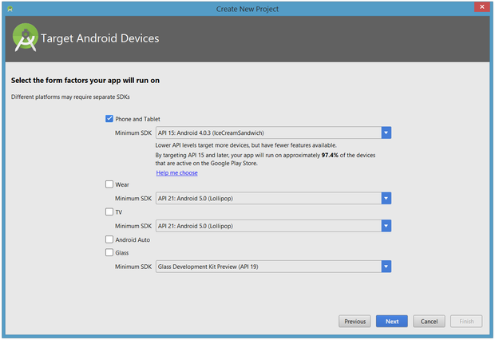
Starting a new project
Select Target device

Slide 5
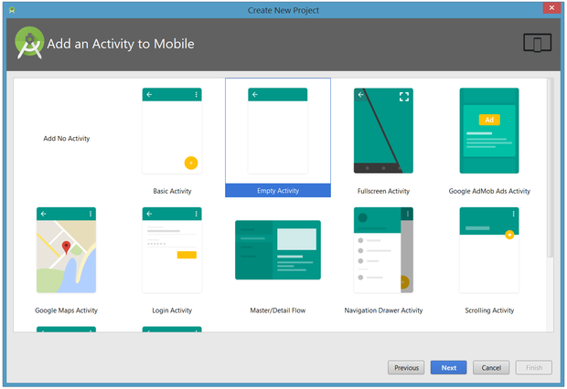
Starting a new project
Choose a template for main activity

Slide 6
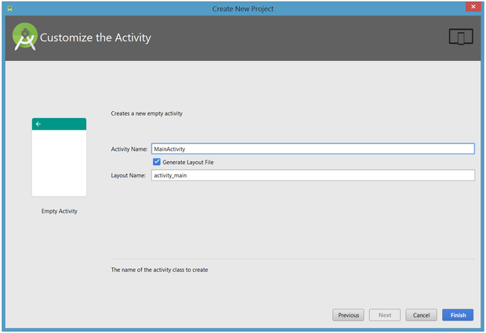
Starting a new project
Activity name – java file name
Layout name- XML file name

Slide 7
Android Studio Designer
Designer tool operates in two distinct modes
  Design mode ( user interface can be visually manipulated by directly working with the view palette and the graphical representation of the layout)
  Text mode ( XML resource file containing the definition of the user interface )

Slide 8
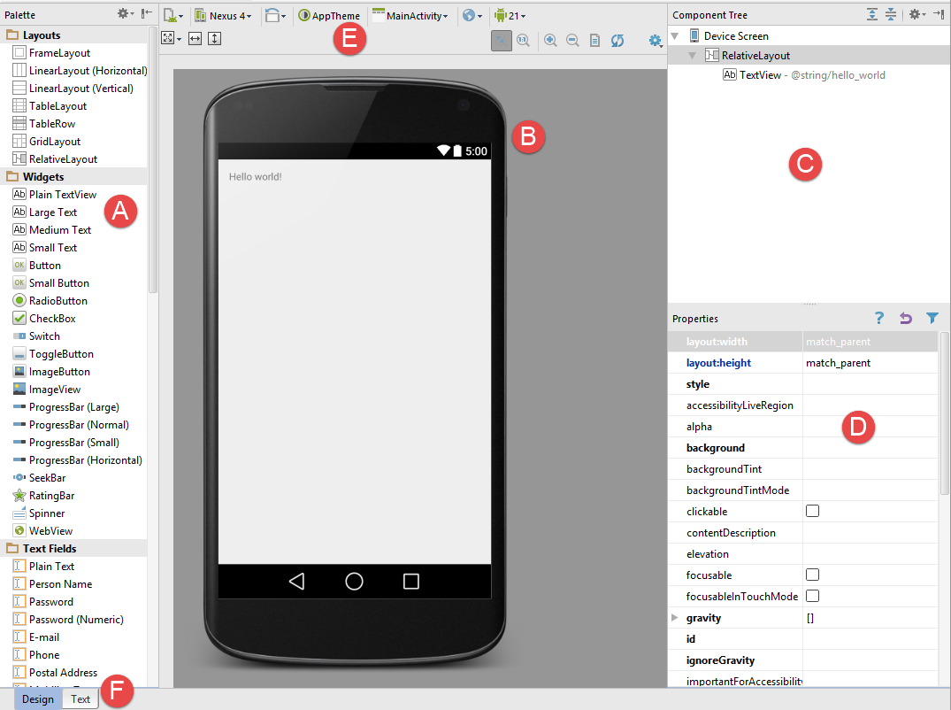
Design mode
A – Palette
B – Device Screen
C – Component Tree
D – Properties
E – Toolbar
F – Mode Switching Tabs

Slide 9
Android Studio Environment
A – Palette
  provides access to the range of components provided by the Android SDK.
  These are grouped into categories for easy navigation.
  Items may be added to the layout either by dragging components from the palette and dropping it at the desired position on the layout
B – Device Screen
  The device screen provides a visual representation of the user interface layout as it is being designed.
  This layout allows for direct manipulation of the device

Slide 10
Android Studio Environment
C – Component Tree
  User interfaces are constructed using a hierarchical structure.
  The component tree provides a visual hierarchy of the user interface design.
  Selecting an element from the component tree will cause the corresponding view in the layout to be selected. Similarly, selecting a view from the device screen layout will select that view in the component tree hierarchy.
D – Properties
  All the component views in the palette have associated properties that can be used to adjust the behavior and appearance of that view.
  The properties panel provides access to the properties of the currently selected view in the layout allowing changes to be made.

Slide 11
Android Studio Environment
E – Toolbar
  The Designer toolbar provides quick access to a wide range of options including, amongst other options
  The toolbar also has a set of context sensitive buttons which will appear when relevant view types are selected in the device screen layout.
F – Mode Switching Tabs
  The tabs located along the lower edge of the Designer provide a way to switch back and forth between the Designer tool’s text and design modes

Slide 12
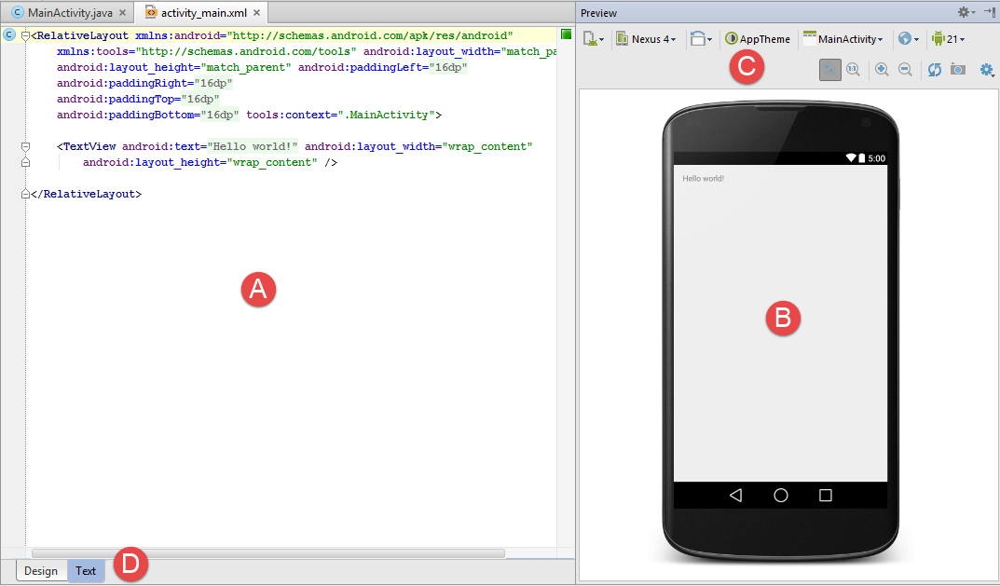
Text mode

Slide 13
Android Studio Environment
A – Editor
  displays the XML that makes up the current user interface layout design.
B – Preview
  As changes are made to the XML in the editor, these changes are visually reflected in the preview window.
C – Toolbar
  provides a subset of functions available in design mode with the addition of a button to take a screenshot
D - Mode Switching Tabs

Slide 14

Running the App
To build and run your app, select Run > Run in the menu bar (or click Run in the toolbar).

Slide 15
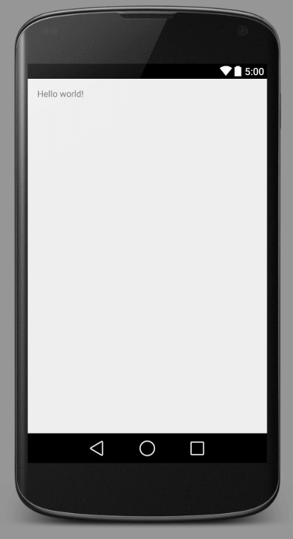
Activity
Single interface
The activity specifies what the app does and how it should respond to the user.

Slide 16
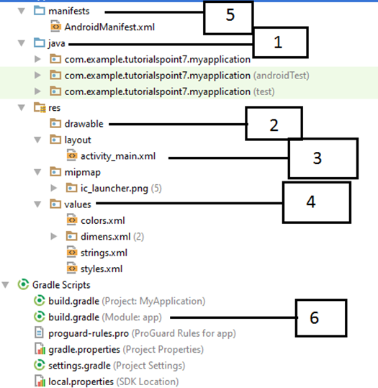

Slide 17
No. | Folder, File & Description
1 | Java This contains the .java source files for your project. By default, it includes an MainActivity.java source file having an activity class that runs when your app is launched using the app icon.
2 | res/drawable-hdpi This is a directory for drawable objects that are designed for high-density screens.
3 | res/layout This is a directory for files that define your app's user interface.
4 | res/values This is a directory for other various XML files that contain a collection of resources, such as strings and colours definitions.
5 | AndroidManifest.xml This is the manifest file which describes the fundamental characteristics of the app and defines each of its components.
6 | Build.gradle These are auto generated file which contains compileSdkVersion, buildToolsVersion, applicationId, minSdkVersion, targetSdkVersion, versionCode and versionName

Slide 18
activity_main.xml
res/layout/activity_main.xml
<RelativeLayout xmlns:android="http://schemas.android.com/apk/res/android"
xmlns:tools="http://schemas.android.com/tools"
android:layout_width="match_parent"
android:layout_height="match_parent"
android:paddingBottom="@dimen/activity_vertical_margin"
android:paddingLeft="@dimen/activity_horizontal_margin"
android:paddingRight="@dimen/activity_horizontal_margin"
android:paddingTop="@dimen/activity_vertical_margin"
tools:context=".MainActivity" >
<TextView
android:layout_width="wrap_content"
android:layout_height="wrap_content"
android:text="@string/hello_world" />
</RelativeLayout>
– RelativeLayouts are quite complicated.

Slide 19
activity_main.xml
Also known as layout file
Located in res/layout directory
@string refers to the strings.xml file located in the res/values folder.
@string/hello_world refers to the hello string defined in the strings.xml file, which is "Hello World!".
dp stands for density-independent pixels

Slide 20
AndroidManifest.xml
Configuration file for the application.
Every Android app must include an AndroidManifest.xml file in its root directory describing functionality
The manifest specifies:
  App’s Activities, Services, etc.
  Permissions requested by app
  Minimum API required
  Hardware features required, e.g., camera with autofocus
  External libraries to which app is linked, e.g., Google Maps library

Slide 21
AndroidManifest.xml
<manifest xmlns:android="http://schemas.android.com/apk/res/android"
package="com.example.pc.hello" >
<application
android:icon="@mipmap/ic_launcher"
android:label="@string/app_name"
android:theme="@style/AppTheme" >
<activity
android:name=".MainActivity"
android:label="@string/app_name" >
<intent-filter>
<action android:name="android.intent.action.MAIN" />
<category android:name="android.intent.category.LAUNCHER" />
</intent-filter>
</activity>
</application>
</manifest

Slide 22
AndroidManifest.xml
Whatever component develop as a part of application, must declare all its components in a manifest.xml which resides at the root of the application project directory.
Works as an interface between Android OS and your application
If you do not declare your component in this file, then it will not be considered by the OS.

Slide 23
MainActivity.java
Source file with .java extension, having an activity class that runs the appp
Actual application file which ultimately gets converted to a Dalvik executable runs the application.
Android apps have multiple points of entry: no main() method

Slide 24
onCreate() is one of methods that an activity is loaded
setContentView() Set the activity content from a layout resource
R.layout.activity_main refers to the activity_main.xml file located in the res/layout folder.
src/…/MainActivity.java
package edu.osu.helloandroid;
import android.os.Bundle;
import android.app.Activity;
import android.view.Menu;
public class MainActivity extends Activity
{
@Override
protected void onCreate(Bundle savedInstanceState)
{
super.onCreate(savedInstanceState);
setContentView(R.layout.activity_main);
}
@Override
public boolean onCreateOptionsMenu(Menu menu)
{
//Inflate the menu; adds items to the action bar if it is present.
getMenuInflater().inflate(R.menu.main, menu);
return true;
}
}

Slide 25
View
Represents the basic building block for user interface components
View occupies a rectangular area on the screen and is responsible for drawing and event handling
Called "widgets"

Slide 26
Resource ID.
A unique resource name for the element, which you can use to obtain a reference to the View from your application.
android:id

Slide 27
Editing TextView component
Properties for width and height
  android:layout_width
  android:layout_height
Values for width and height
  wrap_content
  match_parent
  Specify in dp or sp
sp stands for scale-independent pixels
dp stands for density independent pixels

Slide 28
TextView
Sub class of View class

Slide 29
Editing TextView component
<
TextView android:text="@string/hello_world" android:layout_width="wrap_content"
android:layout_height="wrap_content"
android:textSize="10sp”
android:textColor="#bcf5b1"
android:background="#FFAA66CC“
android:textStyle="bold|italic"
/>
normal
bold
italic
bold | italic

Slide 30
Editing View Properties
in – Inches
mm – Millimeters
pt – Points (1/72 of an inch)
dp – Density-independent pixels. An abstract unit of measurement based on the physical density of the device display relative to a 160dpi display baseline.
sp – Scale-independent pixels. Similar to dp but scaled based on the user’s font preference.
px – Actual screen pixels. Use is not recommended since different displays will have different pixels per inch. Use dp in preference to this unit.

Slide 31
Density Independent Pixels
density-independent pixel( dip, dp) is a physical unit of measurement based on a coordinate system held by a computer and represents an abstraction of a pixel for use by an application that an underlying system then converts to physical pixels.

Slide 32
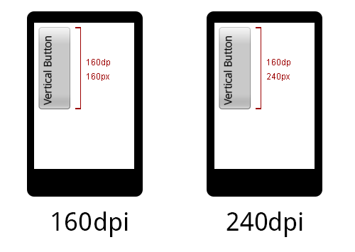
Density Independent Pixels
Display Density | 1 dp equals to
120 dpi (ldpi) | 0.75 px
160 dpi (mdpi) | 1 px
240 dpi (hdpi) | 1.5 px
320 dpi (xhdpi) | 2 px
480 dpi (xxhdpi) | 3 px
640 dpi (xxxhdpi) | 4 px

Slide 33
Insert Image
Add imageView into the layout
Move an image to drawable folder
  \AndroidStudioProjects\ProjectName\app\src\main\res\drawable
Edit xml
  android:src="@drawable/imageName"

Slide 34
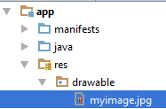
Insert Image
<ImageView
android:layout_height="wrap_content"
android:layout_width="wrap_content"
android:src="@drawable/myimage"
/>

Slide 35
Button
User interface element the user can tap or click to perform an action.
Sub class of View class

Slide 36
Button Click
Using android:onClick= property of button control in xml code
  Cant change the behavior of button while your app is running.
  Call a method in host activity
Using onClickListner() in java code
  Change the behavior of button while your app is running.
  Able to call a method in other activity
  Since it is an interface that any class could implement, this has more flexibility

Slide 37
Button Click
Import required classes
  import android.widget.Button;
  import android.widget.Toast;
    Toast is a quick little message for the user
Declare a button type object
  Button NewButton
Instantiate the Button type object referring the button1 component of activity
  NewButton=(Button)findViewById(R.id.button1);

Slide 38
Button Click
setOnClickListener ()
  Register a callback to be invoked when the button is clicked.
Event listener
  Called when the user clicks
  OnClickListener()
Event Handler
  Event handler to execute actions
  onClick()
Toast
  Toast.makeText(MainActivity.this,"Hi !",Toast.LENGTH_LONG).show();

